Slide 1
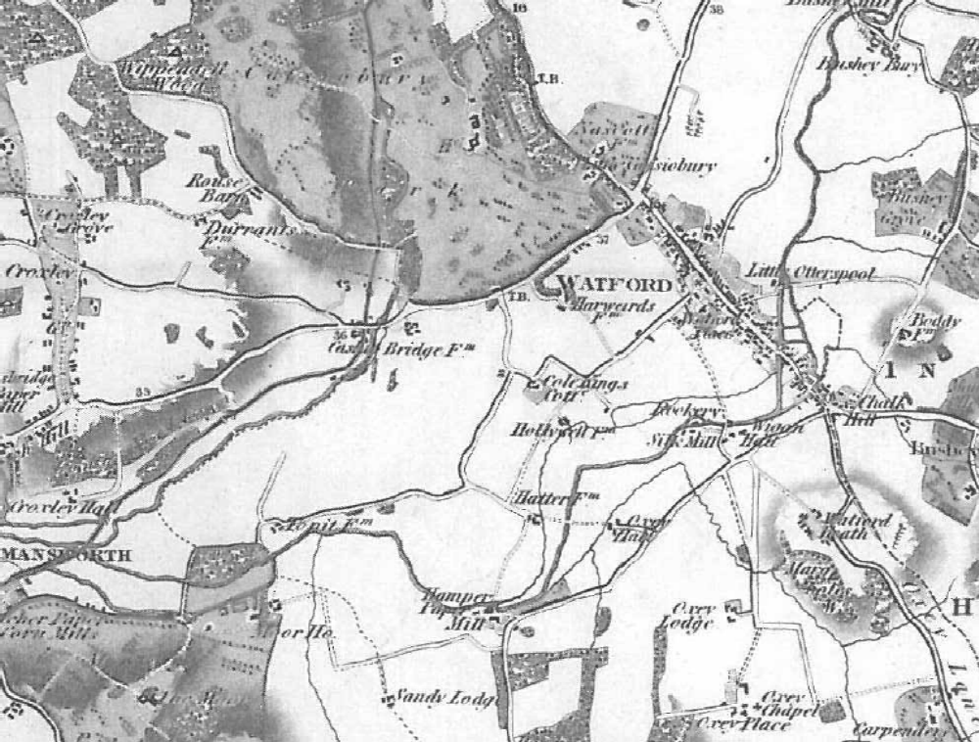
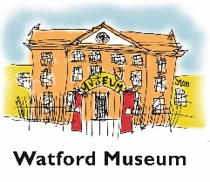
Maps in Watford
About two Miles farther west lies Watford …... The Town is very long, having but one Street, which is the public, and so is extremely dirty in Winter Daniel Defoe wrote this in a book first printed 1724 and 1727, but revised and reprinted many times.
This map is from 1766

Slide 2
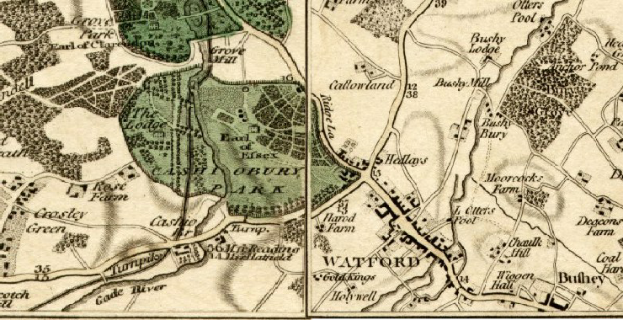
Before the railways came Watford was pretty much along one straight road with the short alleys, courts and yards coming off of it.
The fields were tied to the various farms, next to the boundary lines of the properties on the High Street; the farms were dotted around. This map is from 1800

Slide 3
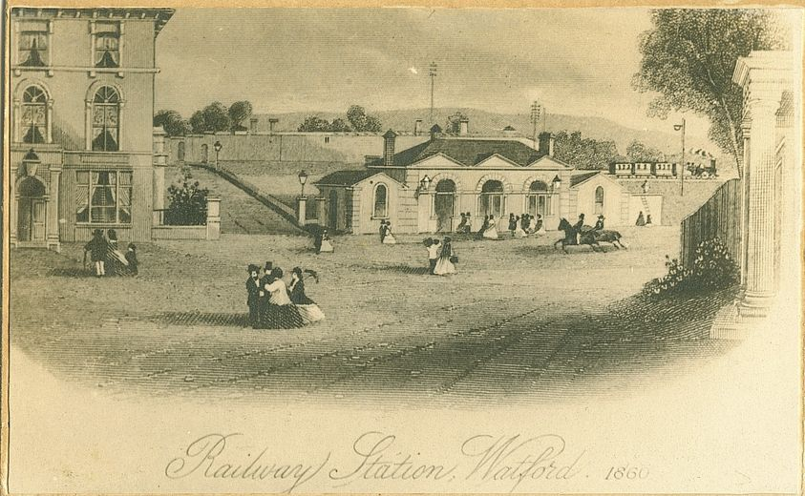
Part of the London and Birmingham Railway opened on 20 July 1837 and ran between Euston and Boxmoor.
In 1837 the town’s first railway station was opened near to the bridge in St. Albans Road. The station had first- and second-class waiting rooms, departure yard, carriage shed, engine house and facilities for pumping water. In 1843 even Queen Victoria and Prince Albert took the train from Watford Station.

Slide 4
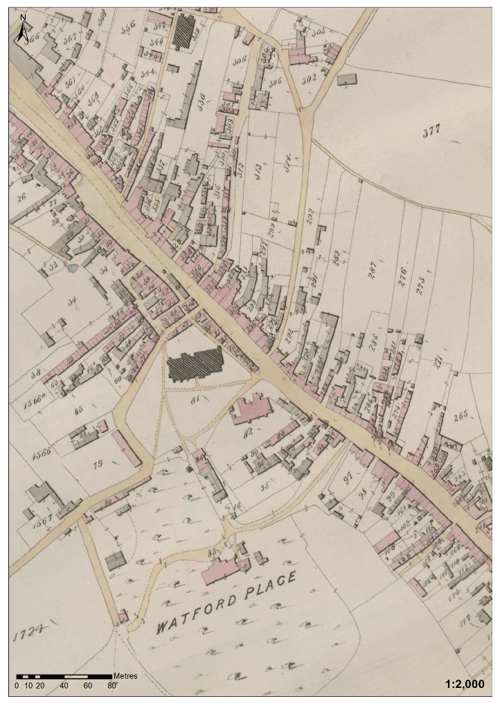
This is part of a tithe map of Watford town centre from 1842. You can see that Watford was mostly one street at this time.
.

Slide 5
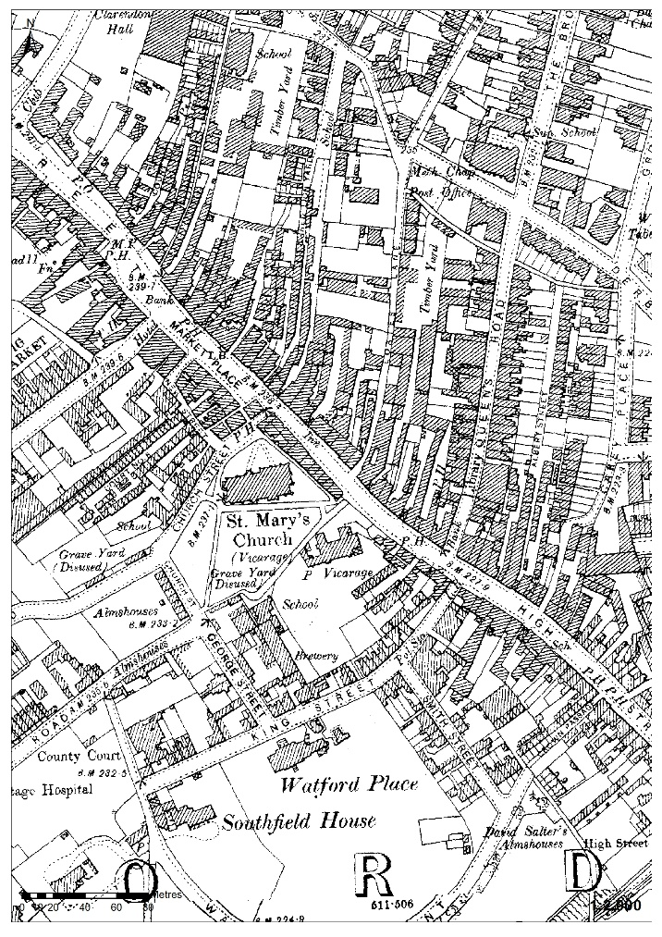
This is a map of the same areaof Watford town centre in the 1890s. Can you see how the area has changed ?
.

Slide 6
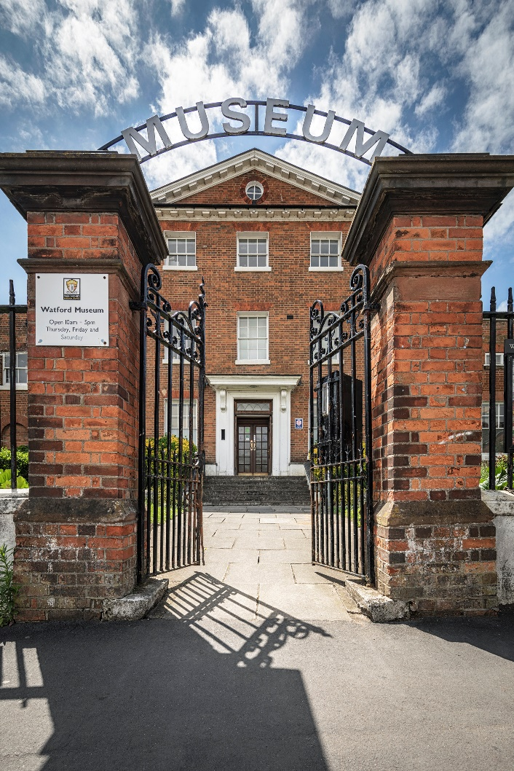
Thank You!
Watford Museum
Open Thursday to Saturday
10am – 5pm
Admission Free
www.watfordmuseum.org.uk

