Slide 1

What Watford means to me
We were delighted to work with Year 7 history students from Watford Girls Grammar school and Watford Grammar school for boys in autumn 22
The students had been set a challenge to learn more about the history of Watford.
They each selected a Watford object , person and building to find something interesting about and produced posters summarizing their research.
Here is a small selection of their work. You can see more at
With many thanks to all students and staff at both schools

Slide 2
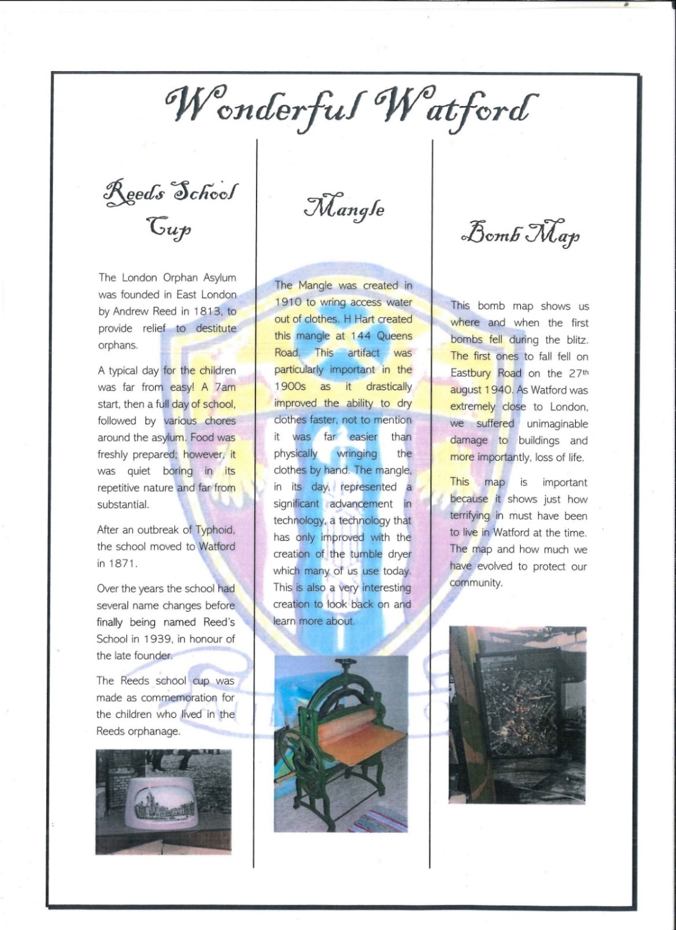

Slide 3
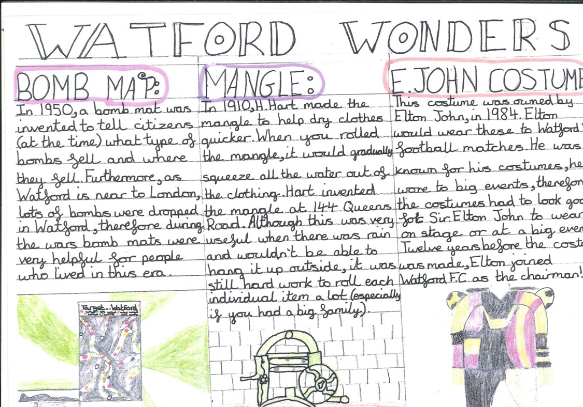
.

Slide 4

.

Slide 5
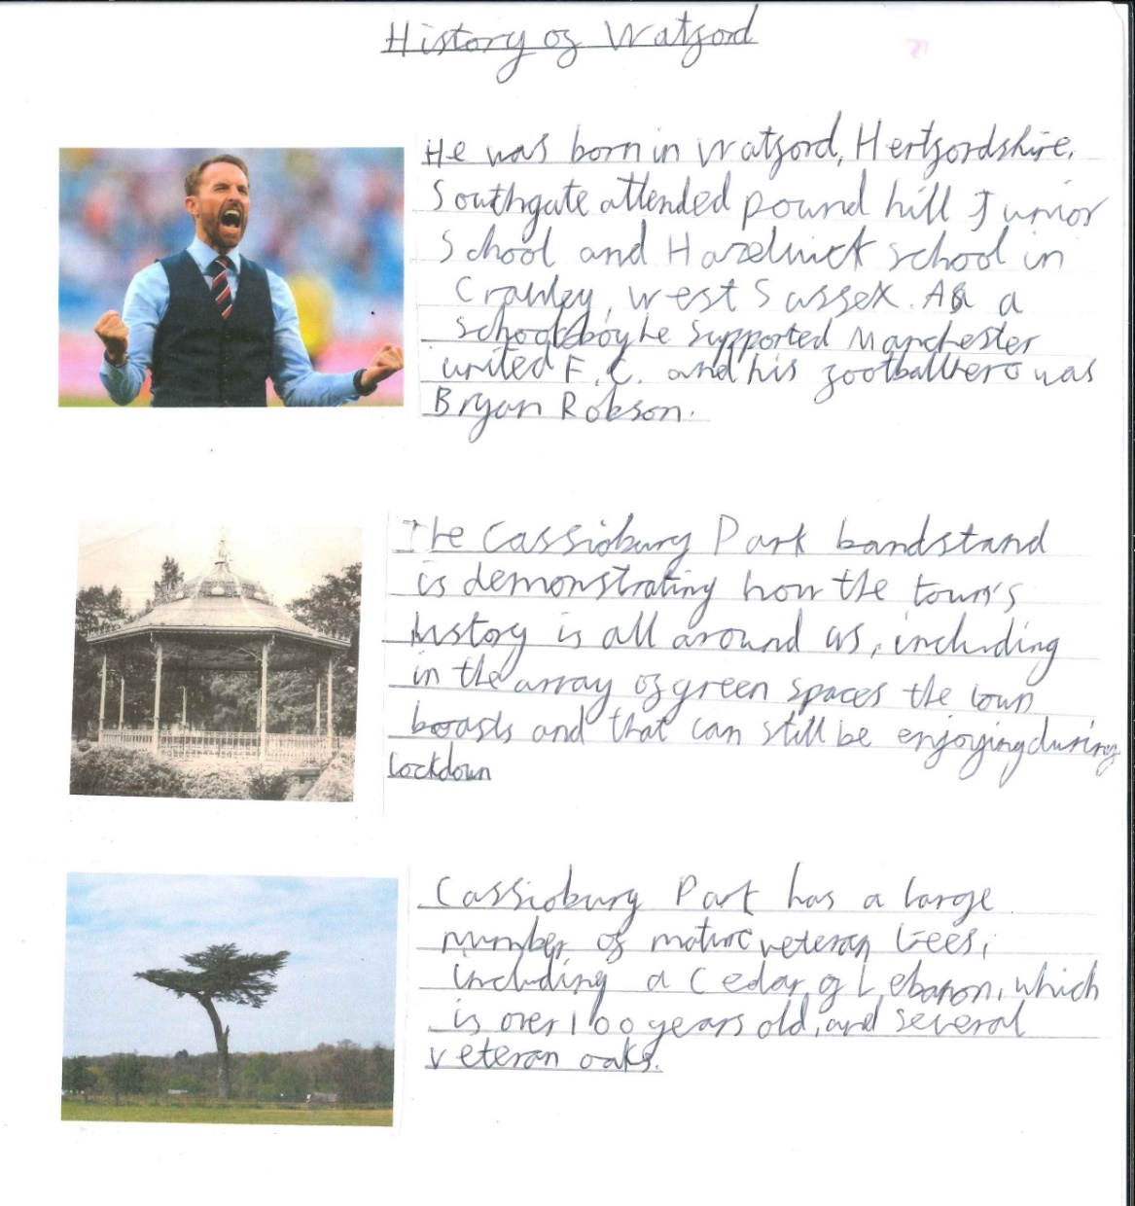
.

Slide 6
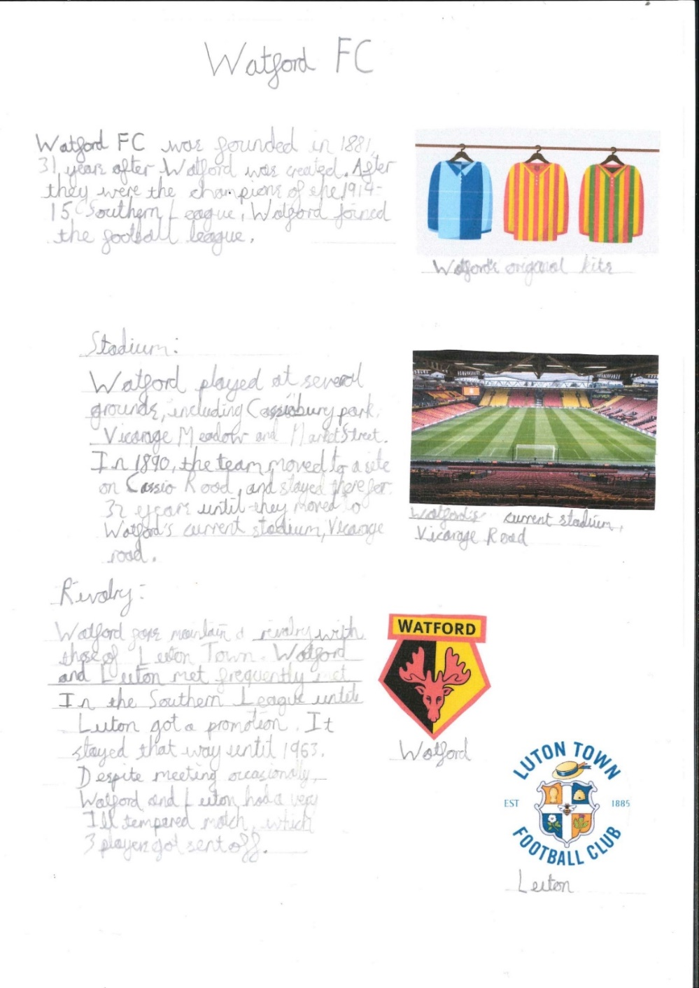
.

Slide 7
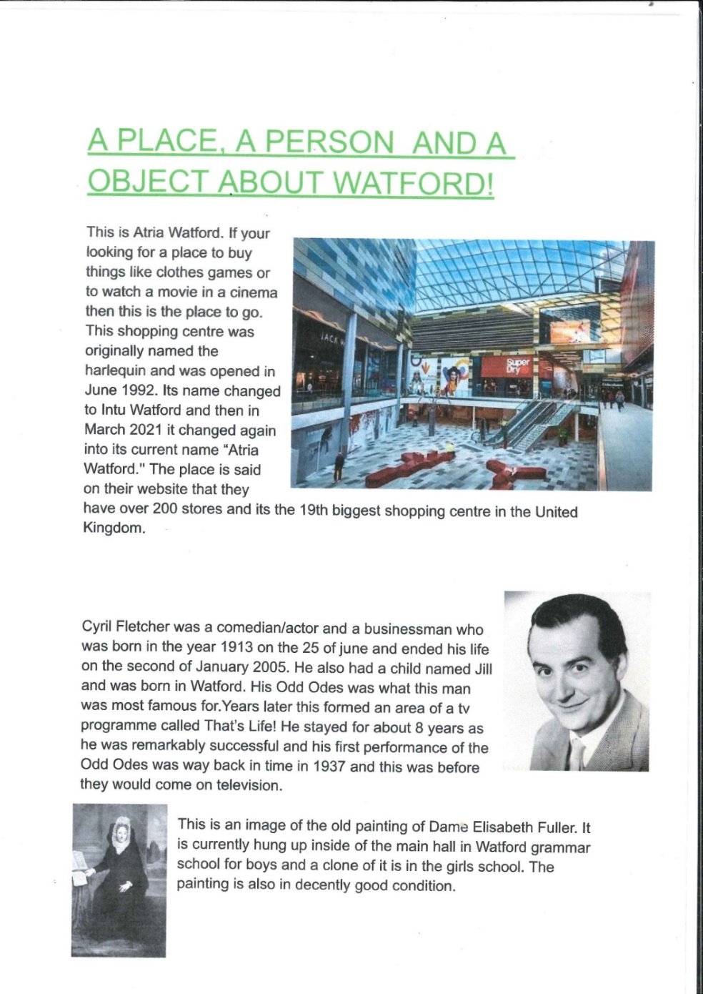
.

Slide 8
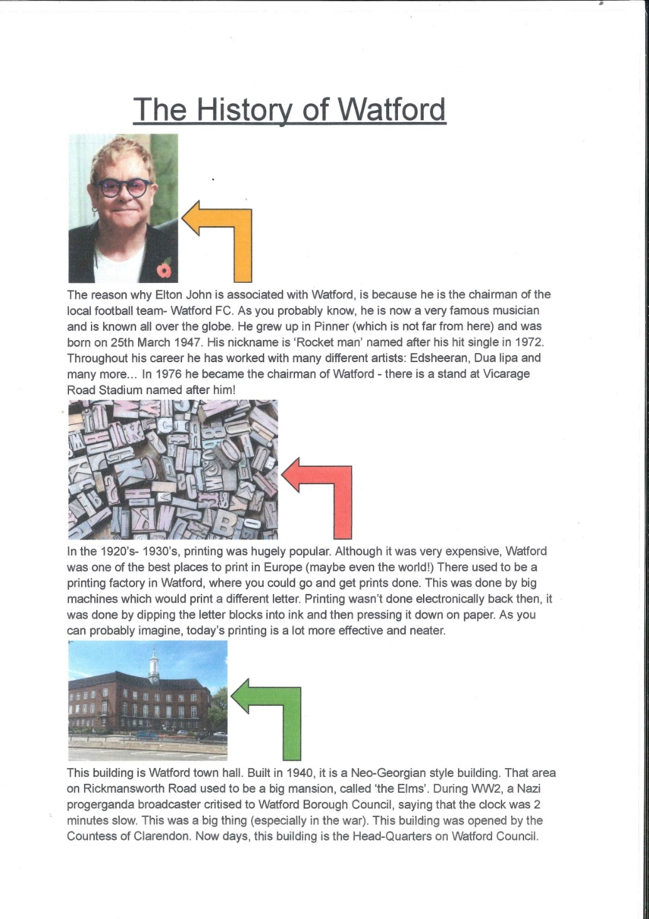
.

Slide 9
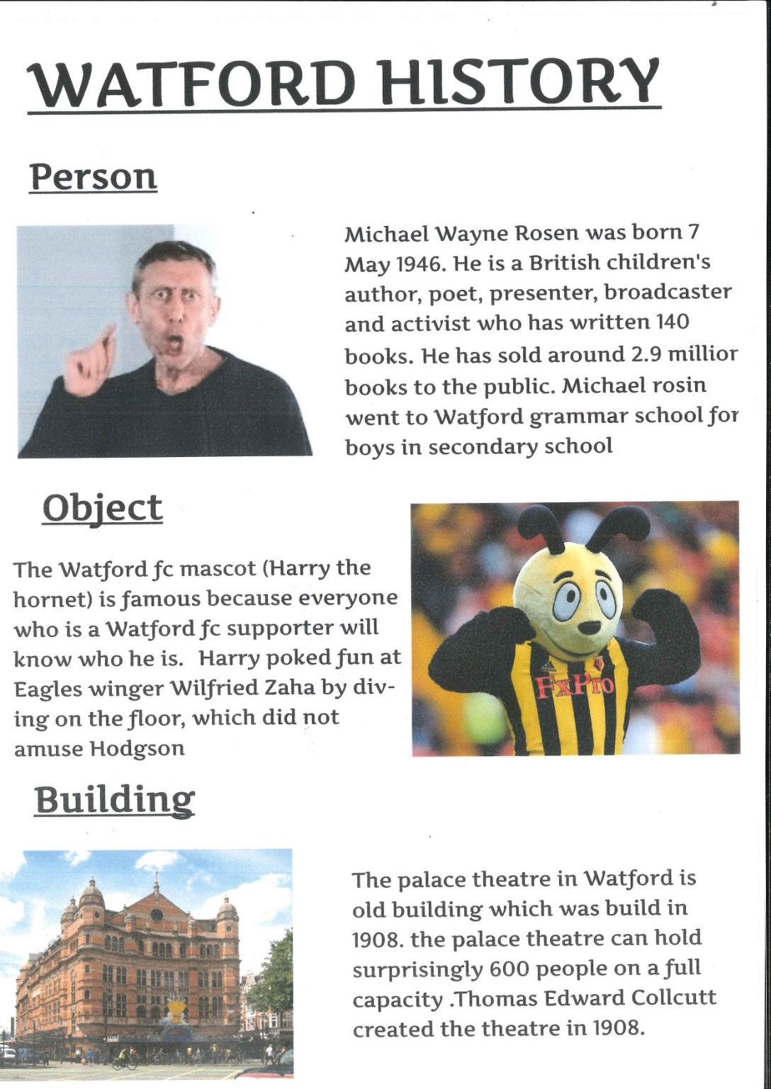
.

Slide 10
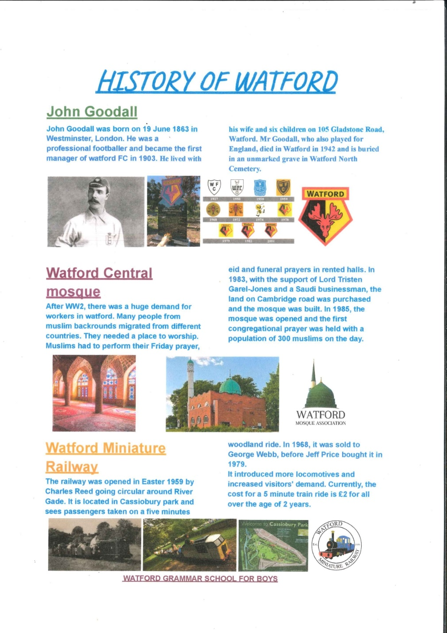
.

Slide 11
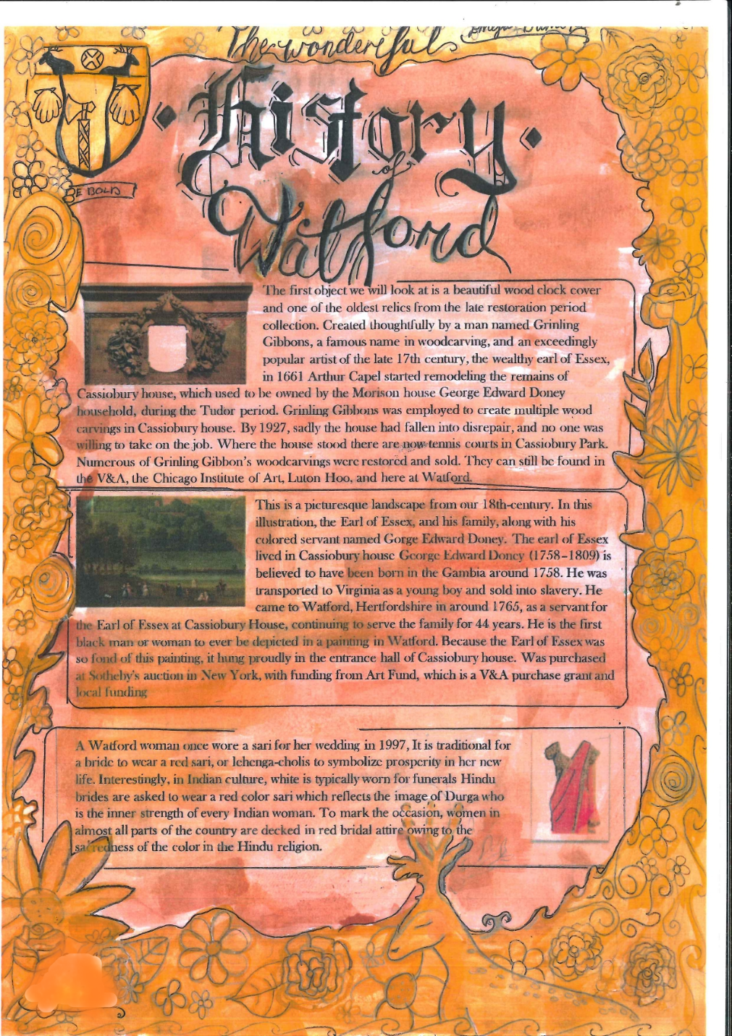
.

Slide 12
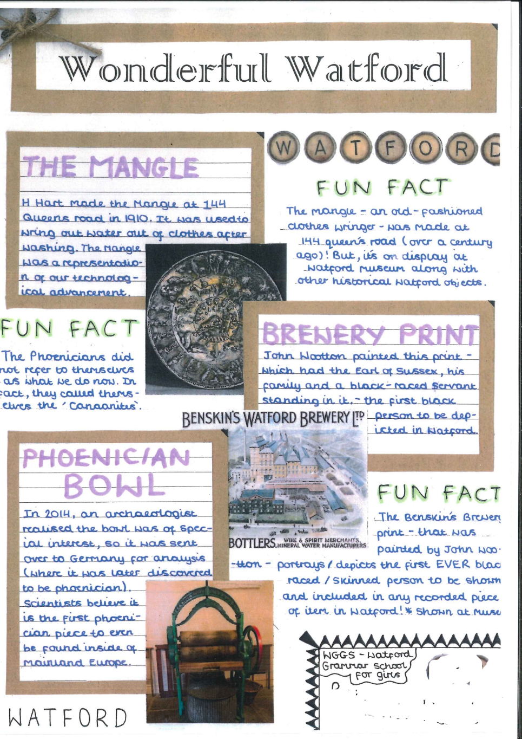
.

Slide 13
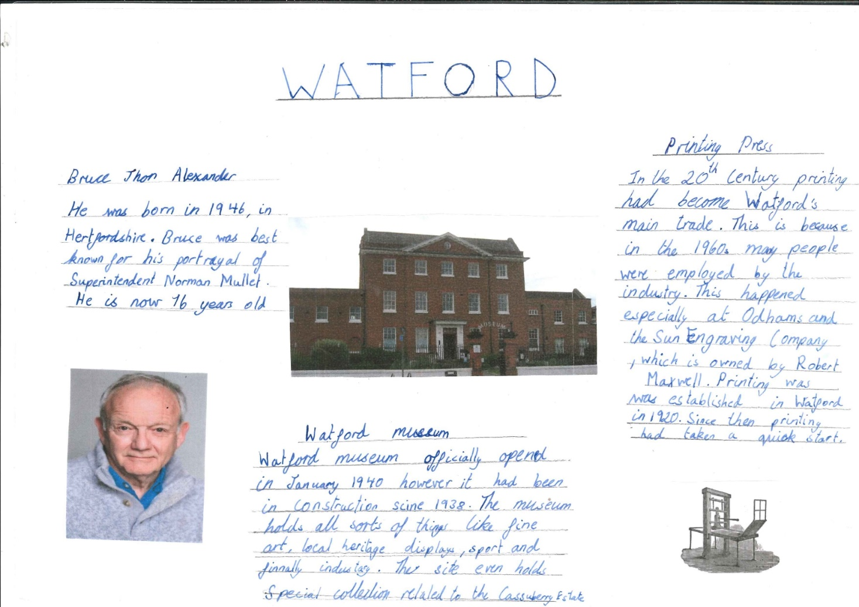
.

Slide 14
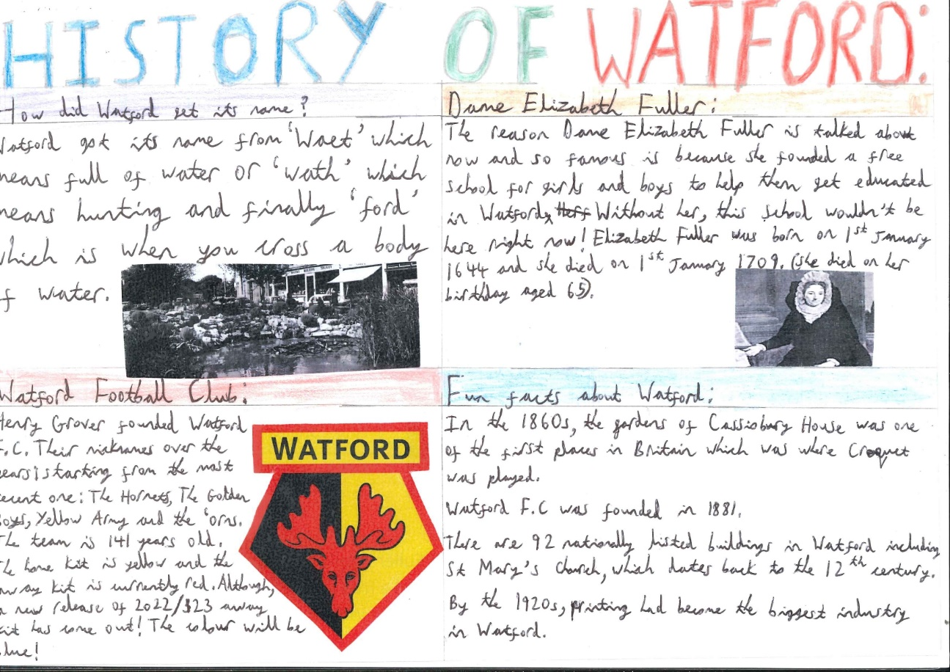
.

Slide 15
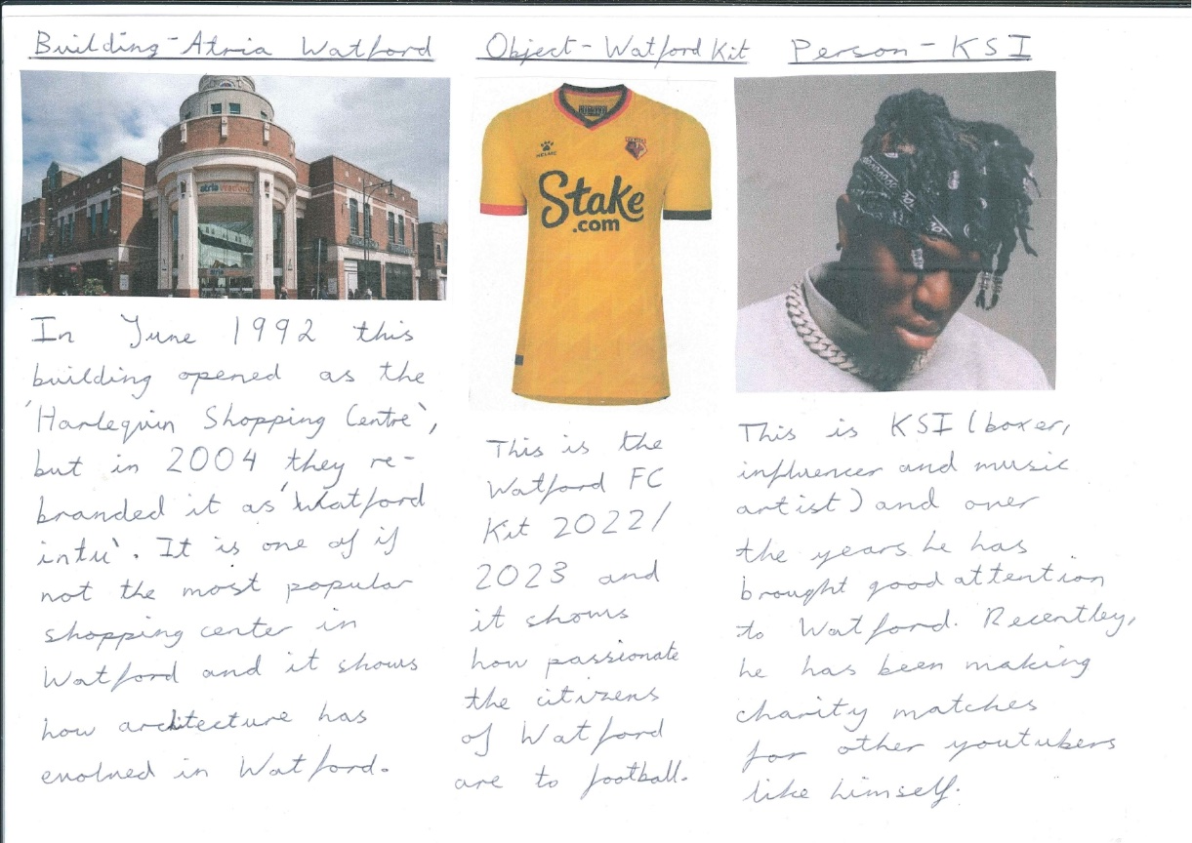
.

Slide 16
.

Slide 17
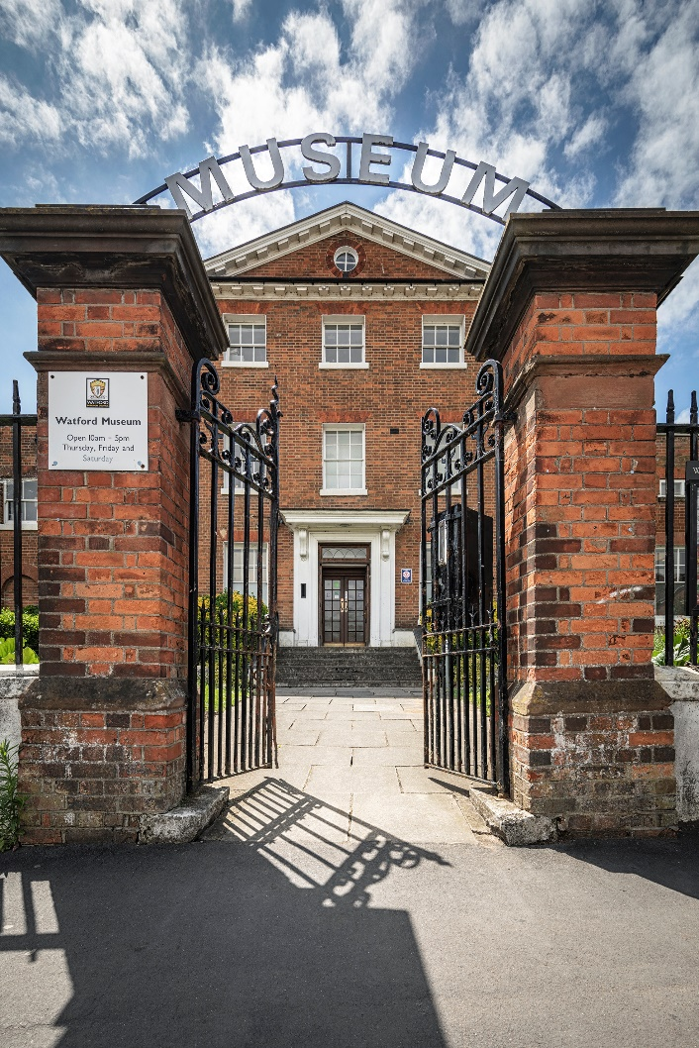
Thank You!
Watford Museum
Open Thursday to Saturday
10am – 5pm
Admission Free
www.watfordmuseum.org.uk

