Slide 1
Watford Museum and it’s Archaeology
A brief introduction to the town and the Museum’s archaeology collection

Slide 2
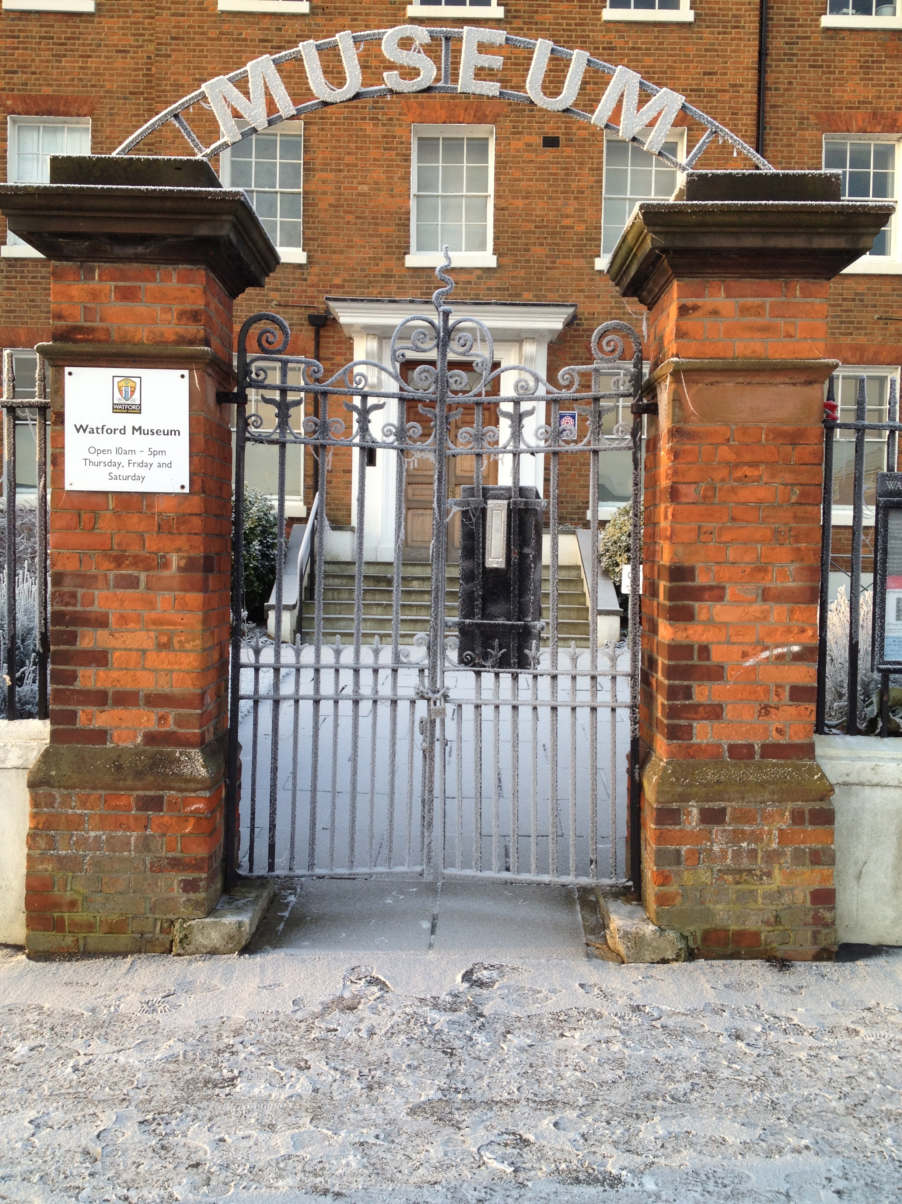
The Museum
Notes:
Watford Museum is a local history museum, which collects and protects material from the Borough of Watford. We opened in 1981 and had approximately 200 objects given to the Museum. This has since grown to an estimated 35,000. The museum is housed in the former offices of the Benskins Brewery, which itself was a Georgian Mansion House built in 1775. We have displays on the local industries; brewing and printing, football,the 19th and 20th Century and of Course Cassiobury and Archaeology.

Slide 3
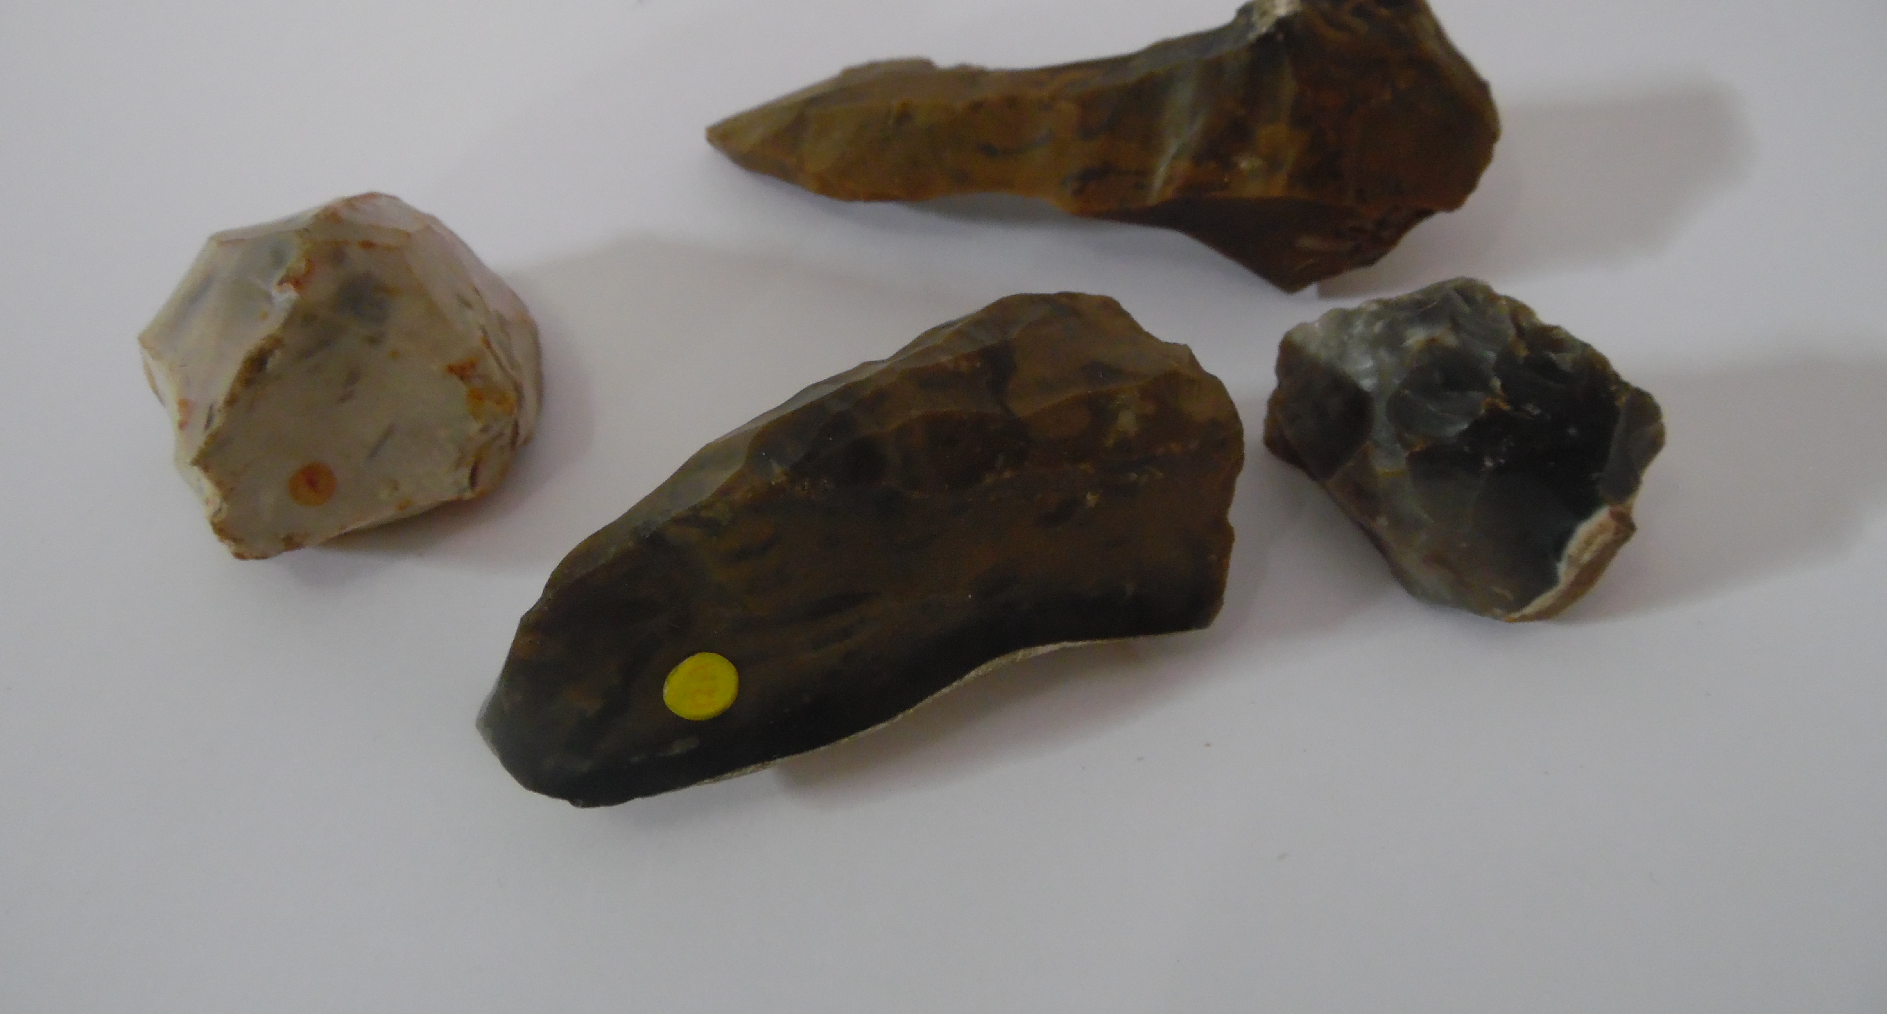
Not much here??
Notes:
When the Museum opened in 1981 it was the only Museum in South West Hertfordshire. The archaeology gallery has changed very little since then and so the display gives a taste for the local area, including Aldenham and Oxhey Hall farm. Watford itself had very little archaeology from pre-history, there have been some casual finds including flint objects, but we are located on a clay based soil which was not ideal for farming.

Slide 4
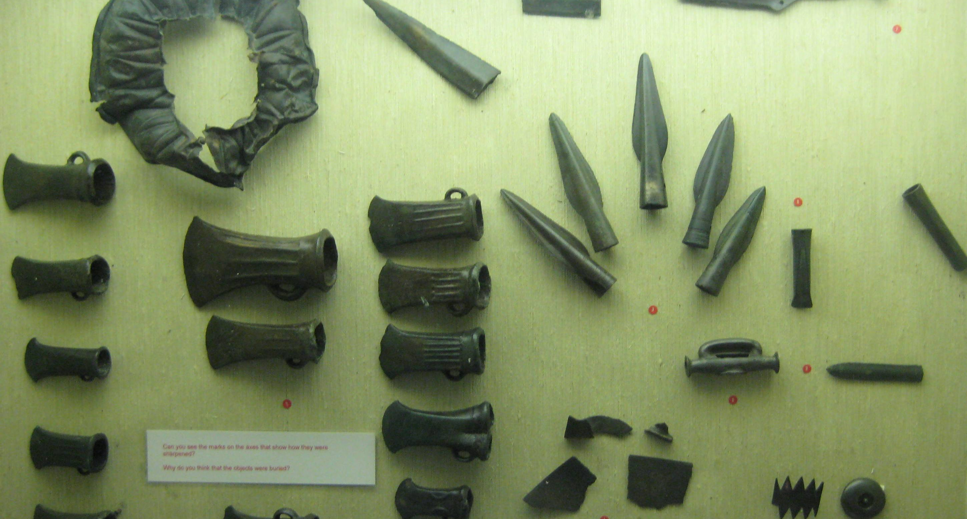
The big find!
Notes:
In 1986 a rather impressive hoard was found in Watford during an archaeological investigation during the construction of the Watford Industrial Estate in the Holywell area. The hoard contained over 60 objects including 22 axes and axe fragments, 11 spearheads, 2 swords, 3 sword fragments and a variety of other objects including copper ingots. Some of the hoard is currently on display upstairs in the Archaeological gallery.

Slide 5
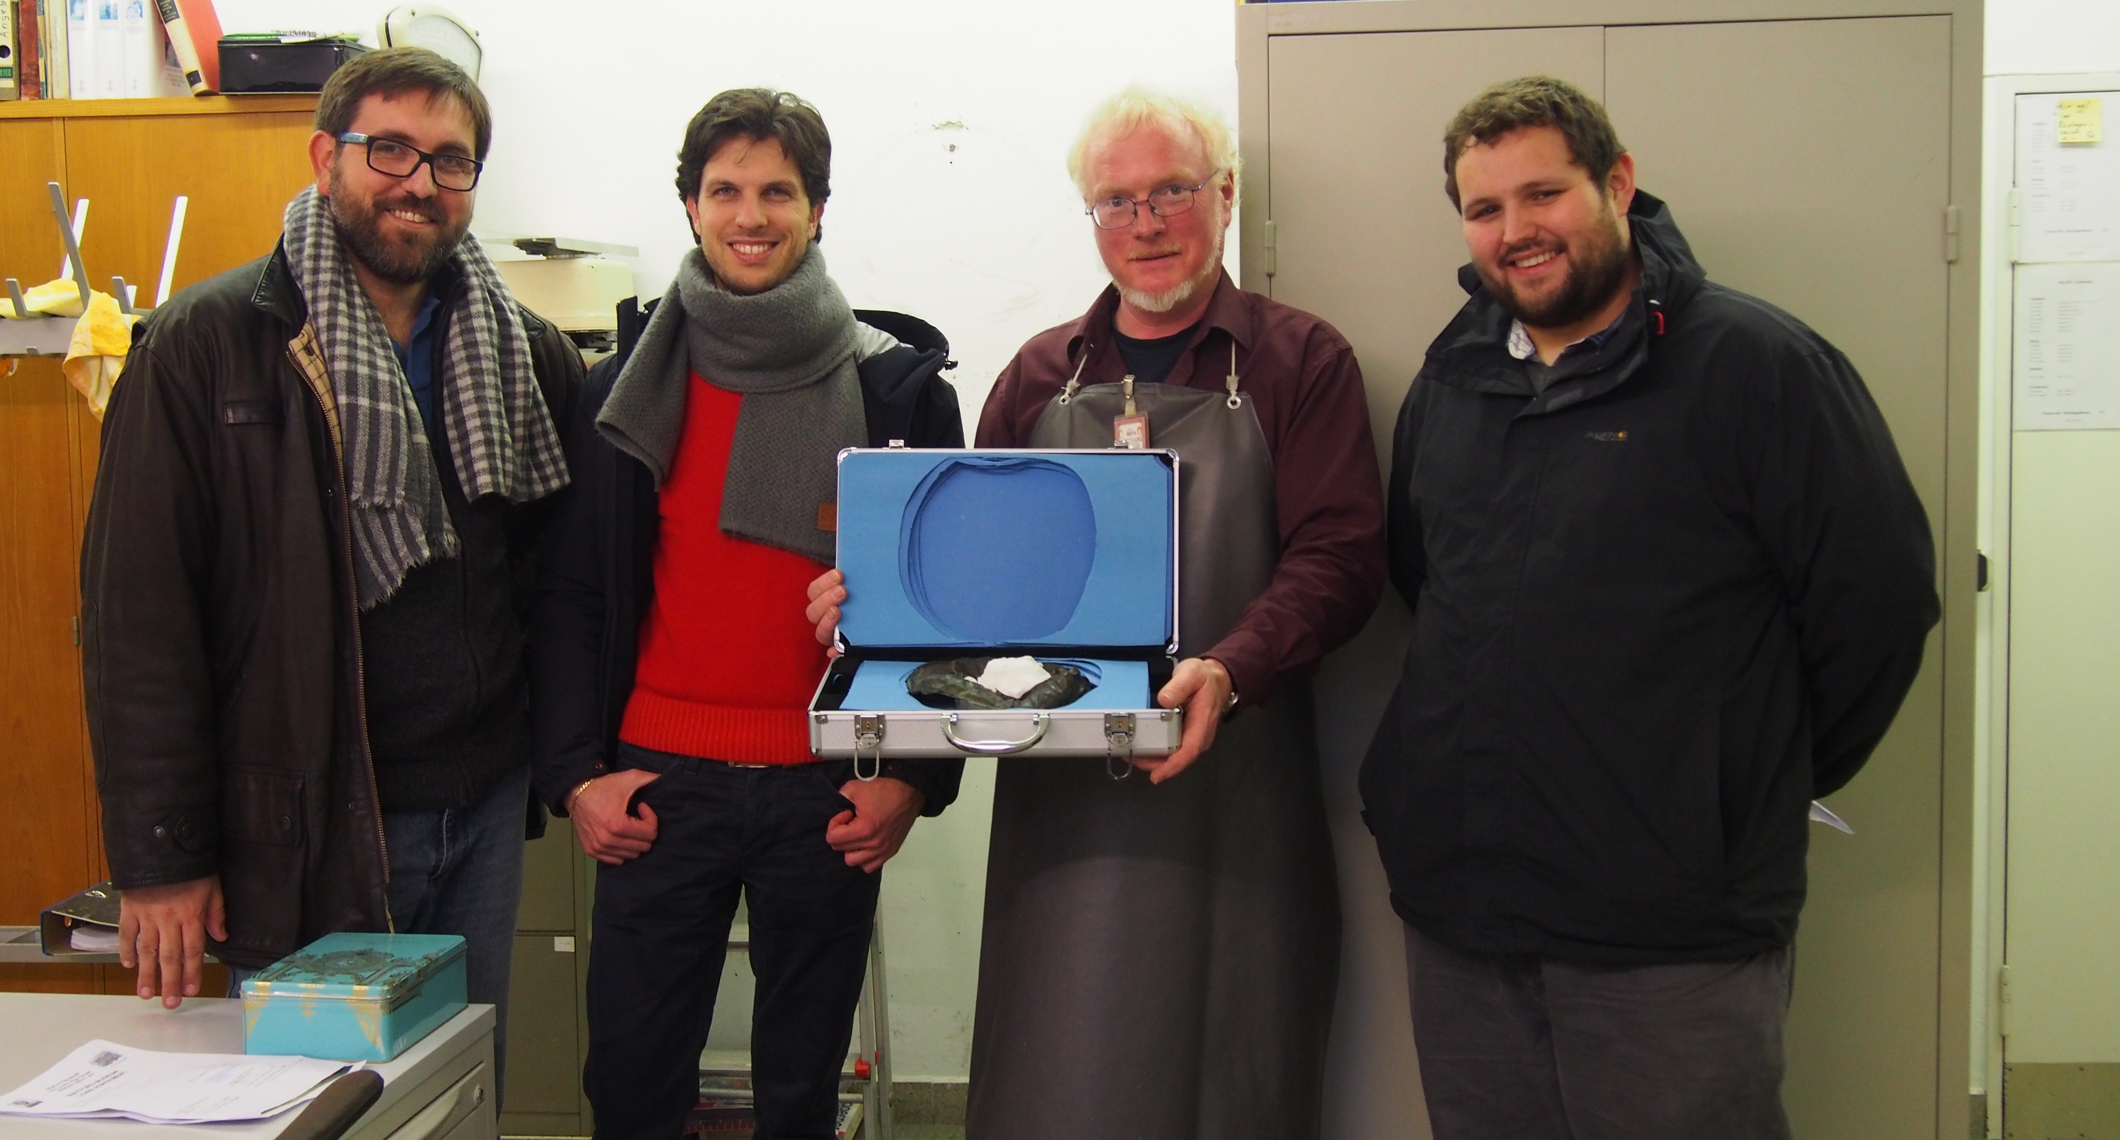
The big find!
Notes:
In 2014 an archaeologist visited Watford to research the hoard and believed we had a rather special piece. The bronze ‘bowl’ as it had been described, was flown out to Germany in December 2014 for further analysis at the RGZM in one of Watford’s twin towns of Mainz. It is believed it could be of Phoenician origin, possibly the top of an incense burner known as a Thymerion, if it is, it will be the first Phoenician piece found in an archaeological context outside mainland Europe. The Phoenicians were an ancient people who were based on the coastline of modern-day Lebanon and Syria, their dominance as maritime traders dates back to around 1,200BC.

Slide 6
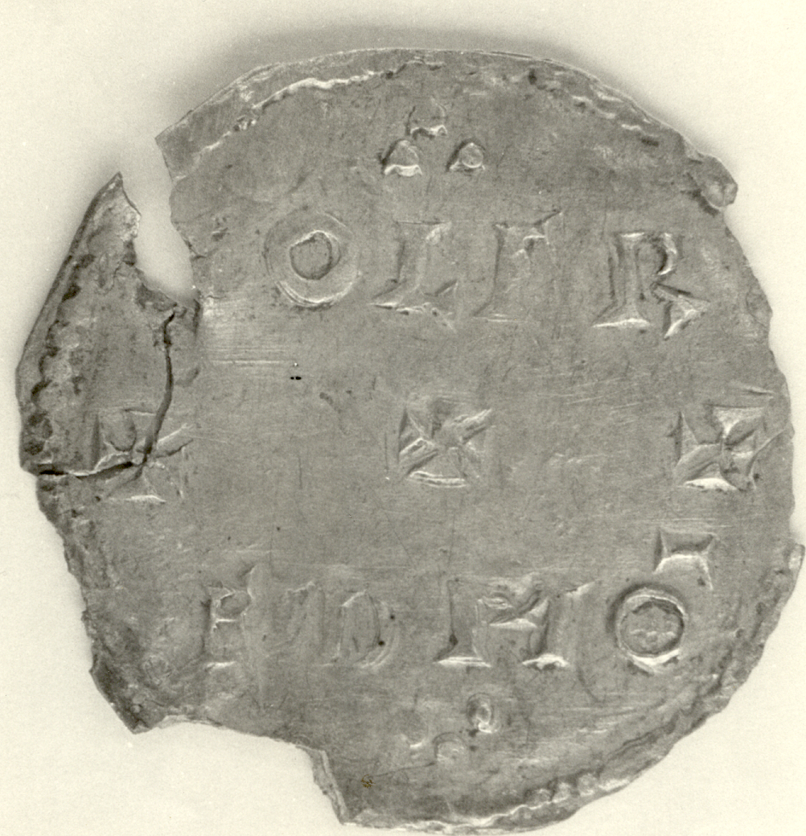
Lost or buried?
Notes:
A hoard of six Anglo Saxon coins were found in 1980 in Whippendell Woods dating from 915-930AD between the reigns of King Edward the Elder and King Aethelstan. They were classed as treasure trove and have been split between us and the British Museum. The four at the Museum are currently on display upstairs. There is no evidence of an Anglo Saxon Settlement in Watford so these would have likely been lost or buried.

Slide 7
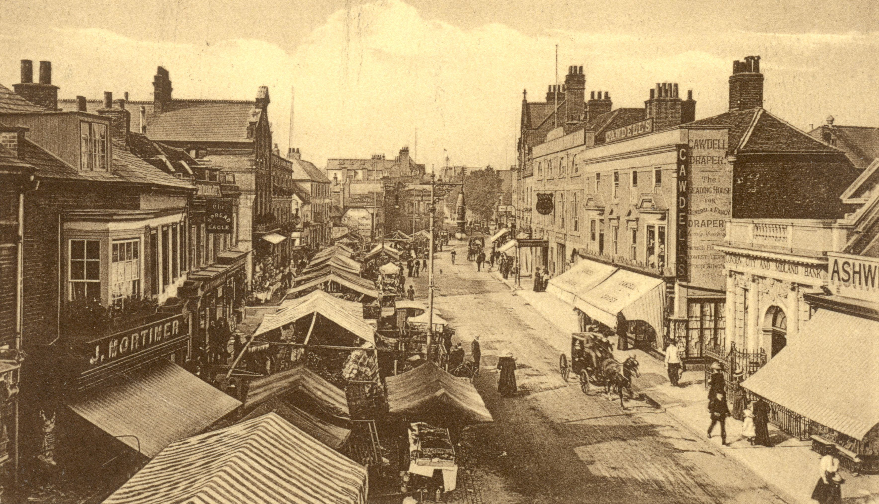
The growth of the town
Notes:
In the 12th Century a market was granted to the Abbot of St. Albans as lord of the Manor, which continued until 1928. The Abbot also arranged for the first church to be built adjacent to the market, St. Mary’s. Little remains of medieval Watford apart from St Mary’s Church, the earliest domestic buildings to survive are the Bedford Almshouses built in 1580.

Slide 8
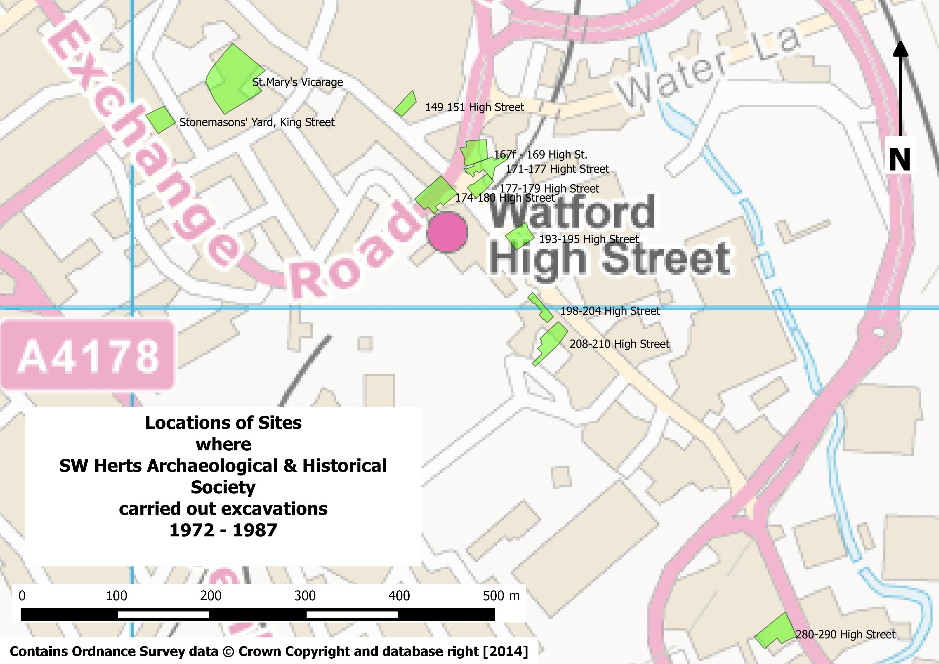
The archaeology of the town
Notes:
Various parts of the town have been excavated as can be seen by the map in the image. There has been some 12th century pottery found, Hertfordshire courseware as well as some Tudor material. Watford Museum are the repository for all archaeological material found in Watford, this is held in an off-site store behind the Museum.

